Slide 1



Capstone Project Bike Sharing Demand Prediction
By – Arjun sharma
(arjunkumarsharma1228@gmail.com)

Slide 2
Introduction
Problem Statement
Dataset introduction
Method use
Insight
Suggestions
Summary

Slide 3

Points for Discussion
01
02
03
04
Problem Statement
Data Description
Data Preparation and Cleaning
EDA (Exploratory Data Analysis)

Slide 4
Points for Discussion
05
06
07
08
09
Hypothesis Testing
Feature Engineering
Modelling
Model Interpretation
Conclusion

Slide 5

Problem Statement
Currently Rental bikes are introduced in many urban cities. The business problem is to ensure a stable supply of rental bikes in urban cities by predicting the demand for bikes at each hour. By providing a stable supply of rental bikes, the system can enhance mobility comfort for the public and reduce waiting time, leading to greater customer satisfaction.

Slide 6

Data Description
The Seoul Bike Sharing Demand dataset contains information about bike rental in Seoul from 2017-2018. It includes hourly observations of 14 columns, such as the date, time, number of rented bikes, weather conditions, and other factors that may influence bike rental demand.
This dataset contains 8760 rows and 14 columns of the data.

Slide 7

Data Description
Date : The date of the observation.
Rented Bike Count : The number of bikes rented during the observation period.
Hour : The hour of the day when the observation was taken.
Temperature(°C) : The temperature in Celsius at the time of observation.
Humidity(%) : The percentage of humidity at the time of observation.
Wind speed (m/s) : The wind speed in meters per second at the time of observation.
Visibility (10m) : The visibility in meters at the time of observation.
Dew point temperature(°C) : The dew point temperature in Celsius at the time of observation.
Solar Radiation (MJ/m2) : The amount of solar radiation in mega-joules per square meter at the time of observation.
Rainfall(mm) : The amount of rainfall in millimeters during the observation period.
Snowfall(cm) : The amount of snowfall in centimeters during the observation period.
Seasons : The season of the year when the observation was taken.
Holiday : Whether the observation was taken on a holiday or not.
Functioning Day : Whether the bike sharing system was operating normally or not during the observation period.

Slide 8
Data Preparation & Cleaning
There are no duplicate rows in the dataset.
There are no missing values or Null values in the dataset.
Change datatype of Date to datetime.
From the Date column, 'month' and 'day of the week' columns are created.
From the 'day of the week' column, 'weekend' column is created where 6 and 7 are the weekends (Saturday and Sunday).
Change Data types of numerical columns which represents categories like Month, Day of the Week, Weekend to categorical data type.

Slide 9
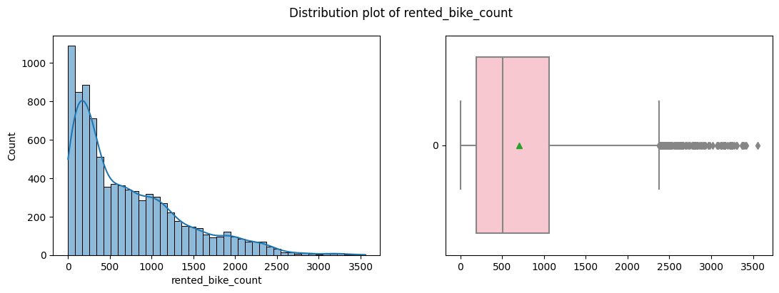
Exploratory Data Analysis
Rented Bike Count Distribution

Slide 10
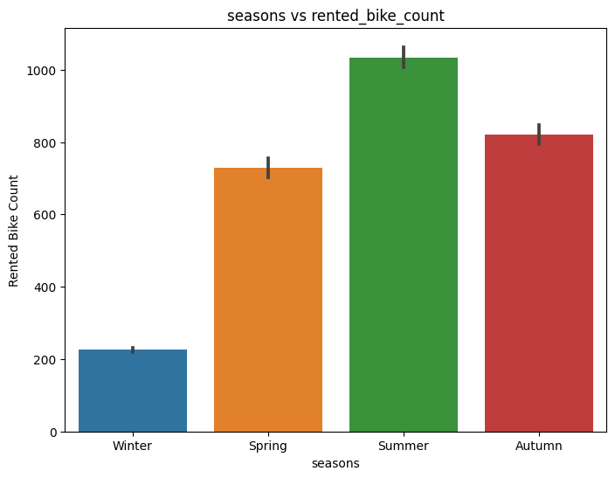
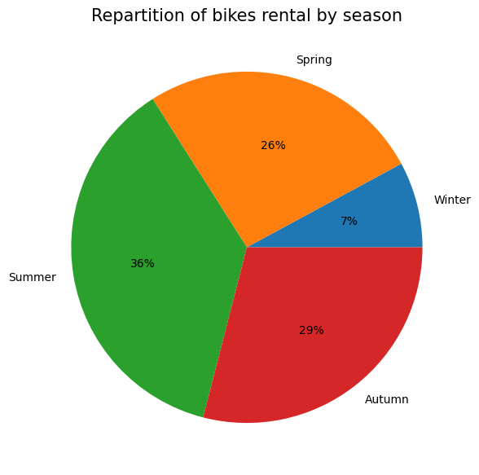
Exploratory Data Analysis
Rented Bike Count by Seasons
Rental Bike demand in winter season is significantly lower than other seasons.
Demand is highest in Summer.

Slide 11
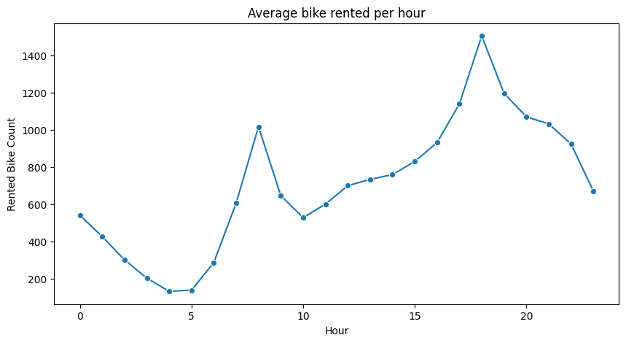
Exploratory Data Analysis
Rented Bike Count by Hour
We can see demand peaks during rush hours of the day.
Rush hour is generally around 8AM in the morning and 6PM in the evening.

Slide 12
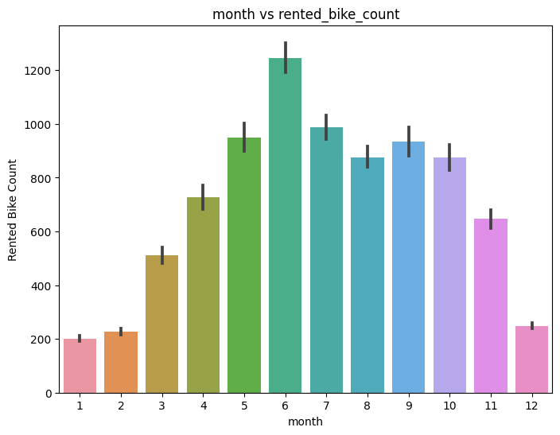
Exploratory Data Analysis
Rented Bike Count by Months
Similar to what we saw with seasons, demand decreases significantly during winter months like Dec, Jan, Feb etc.
Demand peaks at the summer months like May, June, July etc.

Slide 13
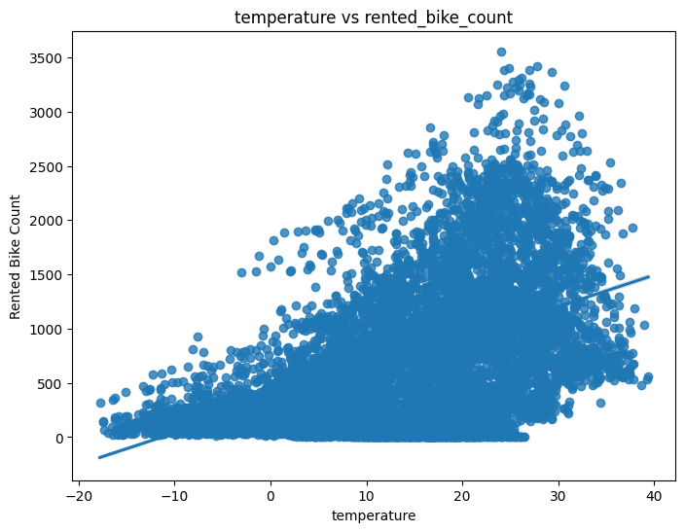
Exploratory Data Analysis
Rented Bike Count by Temperature
The Bike rental demand increases as the temperature increases.
Although too high temperature leads to decrease in demand again.

Slide 14
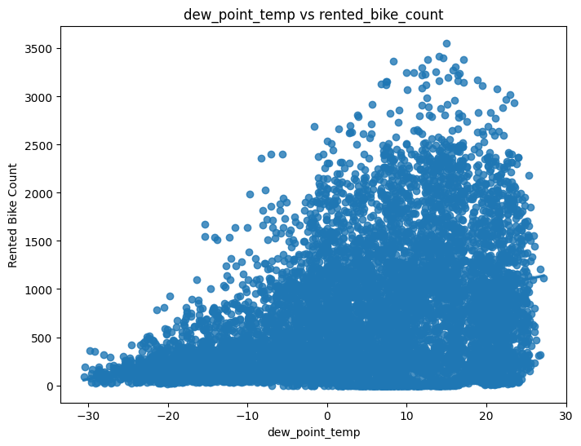
Exploratory Data Analysis
Rented Bike Count by Dew Point Temperature
Similar trend for dew point temperature as well i.e., The Bike rental demand increases as the temperature increases.
Although too high dew point temperature leads to decrease in demand again.

Slide 15
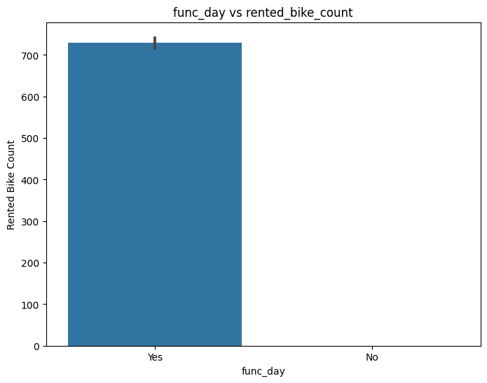
Exploratory Data Analysis
Rented Bike Count by Functioning Day
Obviously on non functioning day i.e., when the bike renting service was not operating, there was zero bikes rented.

Slide 16
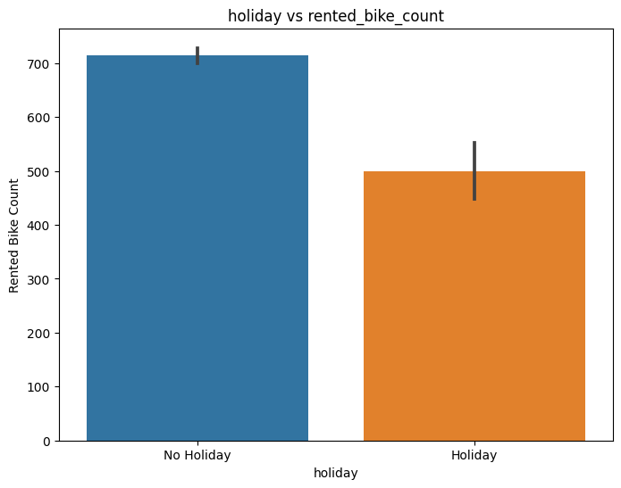
Exploratory Data Analysis
Rented Bike Count by Holiday
Rental Bike demand is higher on non holiday compared to holiday.
Possible reason for this can be that a lot of people uses rental bike to go to offices or schools/ colleges on non holiday.

Slide 17
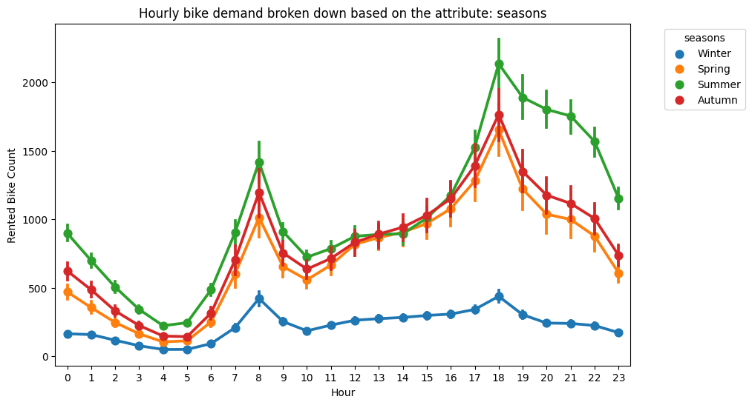
Exploratory Data Analysis
Rented Bike Count by Hour by each Season
We can see demand peaks during rush hours of the day.
Each season has similar hourly pattern only levels are different.

Slide 18
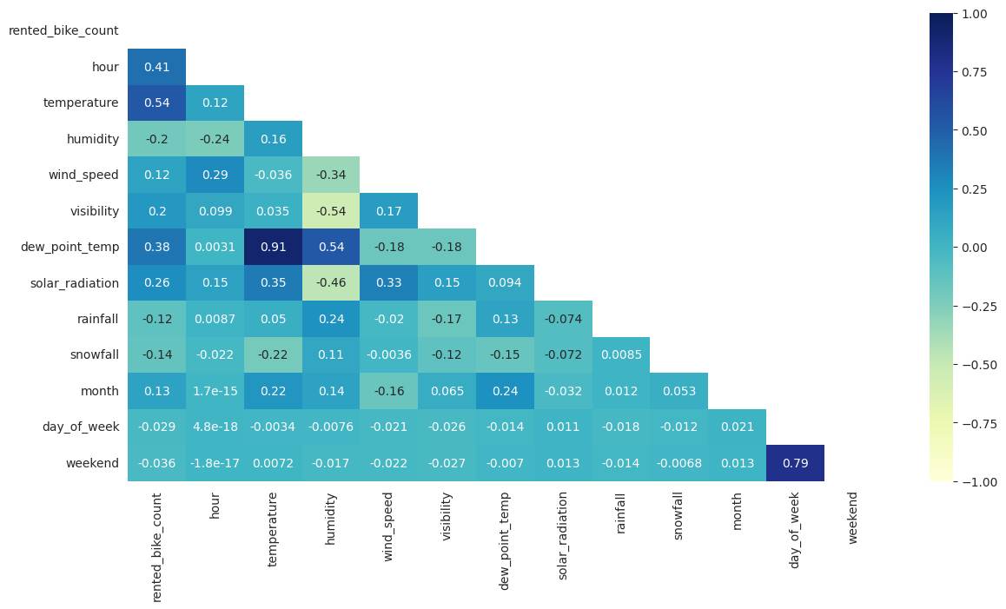
Exploratory Data Analysis
Correlation of features
Temperature and Dew Point Temperature are highly correlated which can create problem while doing model interpretation.
Hence will be dropping Dew Point Temperature later before modelling.

Slide 19
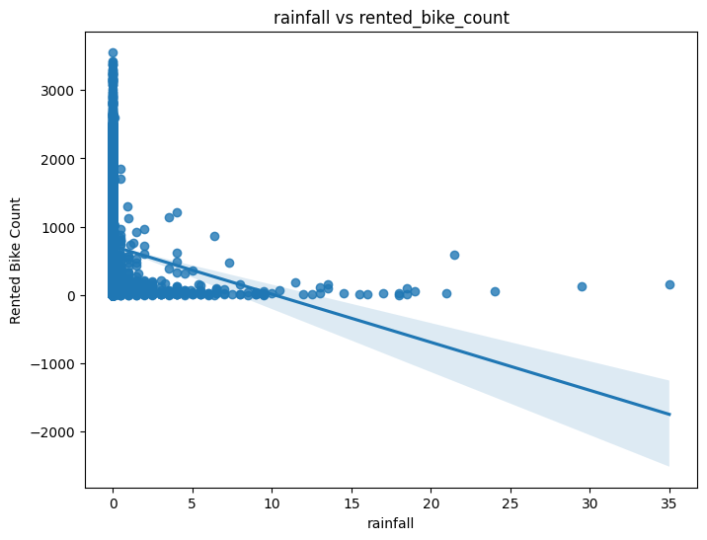
Exploratory Data Analysis
Rented Bike Count by Rainfall
Rainfall leads to decrease in the demand in bike rentals.
This is obvious because people do not want to go out on a bike when it is raining unless it is emergency.

Slide 20
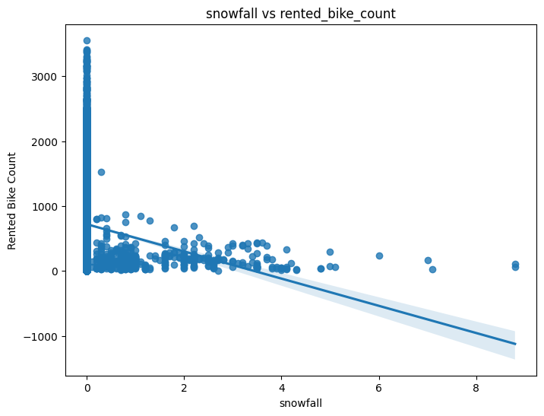
Exploratory Data Analysis
Rented Bike Count by Snowfall
Similarly snowfall leads to decrease in the demand in bike rentals.
This is obvious because people also do not want to go out on a bike when it is snowing unless it is emergency.

Slide 21
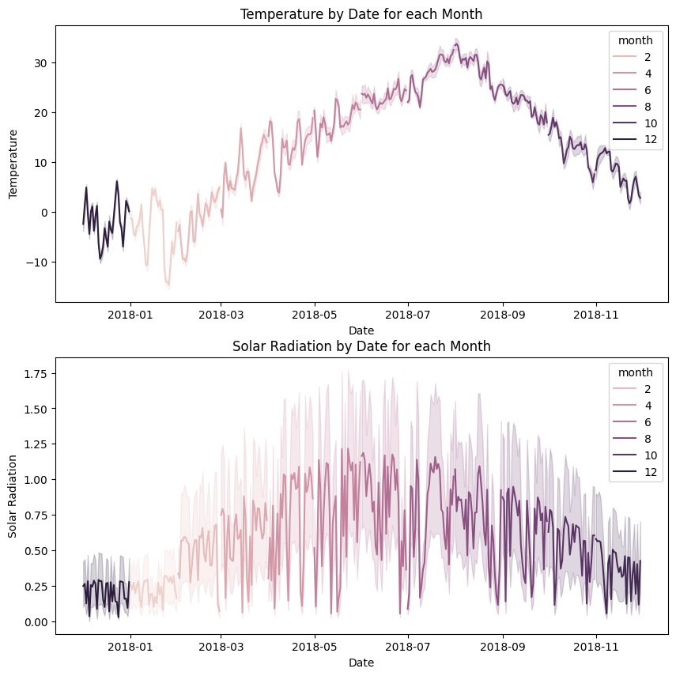
Exploratory Data Analysis
Temperature and Solar Radiation over time
As expected temperature rises during summer months like May, June, July etc. and decreases during months like Dec, Jan etc.
Similar trend for solar radiation as well, but one thing to observe that there are huge fluctuations in the value, it may be because of day-night cycle, as there is no sunlight at night-time.

Slide 22
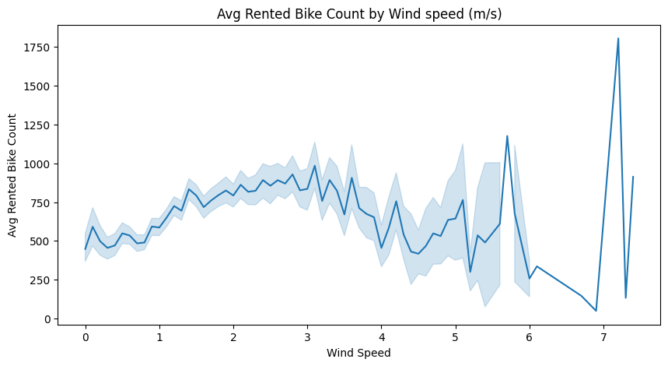
Exploratory Data Analysis
Rented Bike Count by Wind Speed (m/s)
There is a slight increase in demand as wind speed increases but too much wind speed leads to slight decreases in demand.

Slide 23
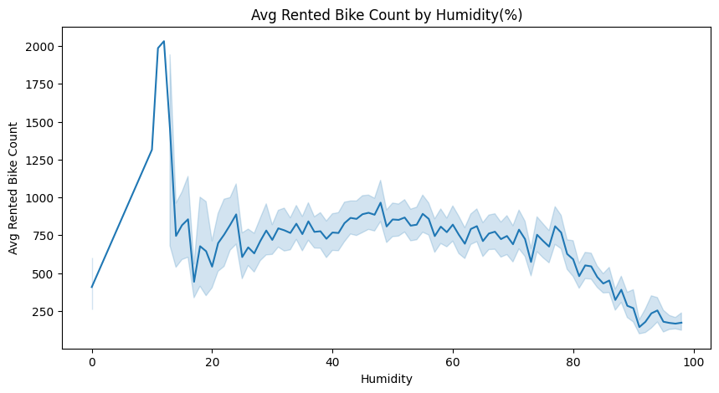
Exploratory Data Analysis
Rented Bike Count by Humidity
The demand is consistent for humidity till 75% but after that is starts decreasing.
One reason for such high humidity can be rain and we already saw rain causes decreases in demand.

Slide 24
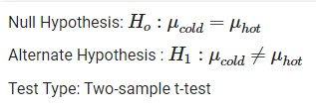
Hypothesis Testing
Rented Bike Demand in hot weather is higher compared to demand in cold weather.
Assumed threshold as 20°C for hot and cold.
The two sample t-test is used to determine if there is a significant difference between the means of two groups.
Also we know from previous charts that Rented Bike Count is right skewed with large sample sizes (i.e., nhot = 2928 & ncold = 5832) and we don't know σp.

Slide 25
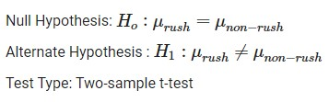
Hypothesis Testing
Rented Bike Demand during rush hour (7-9AM & 5-7PM) is higher compared to non-rush hour.
The two sample t-test is used to determine if there is a significant difference between the means of two groups.
Also we know from previous charts that Rented Bike Count is right skewed with large sample sizes (i.e., nrush = 2190 & nnon−rush = 6570) and we don't know σp.

Slide 26
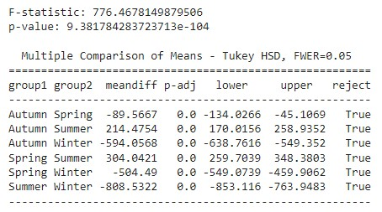

Hypothesis Testing
Rented Bike Demand is different in different seasons with highest in summer and lowest in winter.
The one-way ANOVA test is used to determine if there is a significant difference between the means of more than two groups.
Also we know from previous charts that Rented Bike Count is right skewed with large sample sizes (i.e., nautumn = 2184, nspring = 2208, nsummer = 2208, nwinter = 2160).

Slide 27
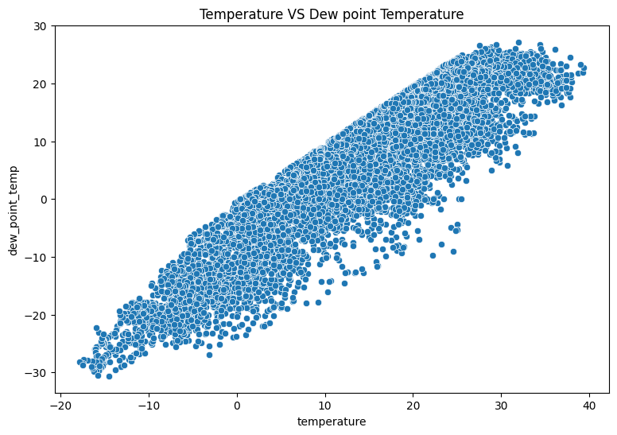
Feature Engineering
I have used pearson correlation coefficient to check correlation between variables and also with dependent variable.
And also i check the multicollinearity using VIF and remove those who are having high VIF value.
Found that there is high correlation between temperature and dew point temperature. So, i take 50 % of the both and create new variable 'temp' by adding both of them.

Slide 28
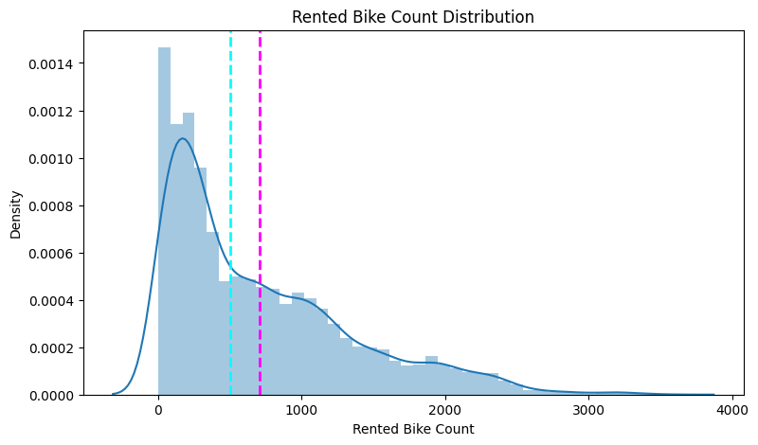
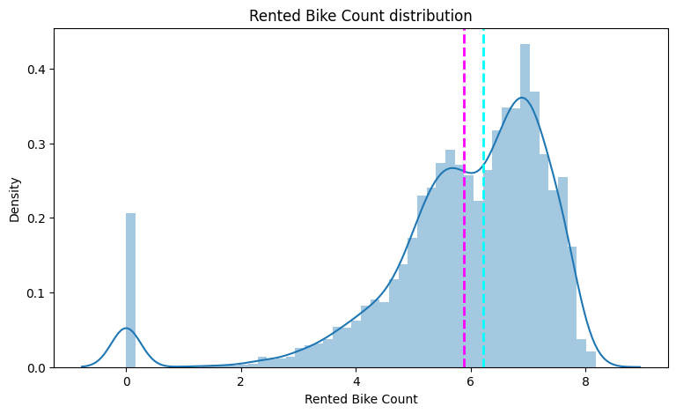
Feature Engineering
The Rented Bike Count was right skewed, and to train a robust model transform it to normal.
Applied square root to transform it to normal.

Slide 29
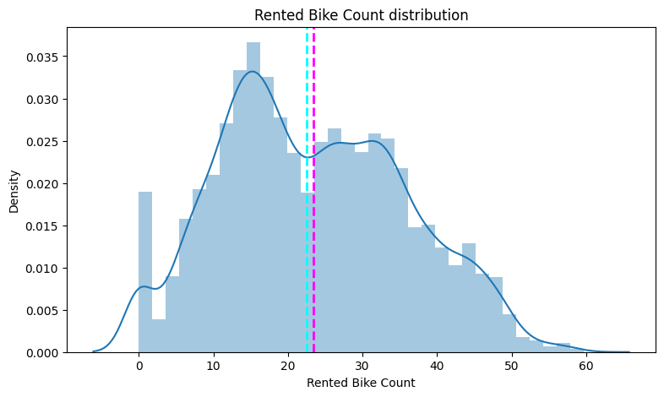
Feature Engineering
I have different independent features of different scale so i have used standard scalar method to scale our independent features into one scale.
Splitted Data into train and test sets with ratio 80:20.

Slide 30

Modelling
01
02
03
04
05
06
07
Since we’re trying to predict continuous variable, I trained various regression algorithms along with hyper parameter tuning and cross validation to get the best model.
Linear Regression
Lasso Regression
Ridge Regression
Decision Tree
Random Forest
Gradient Boosting
Xtreme Gradient Boosting

Slide 31
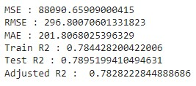
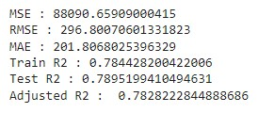
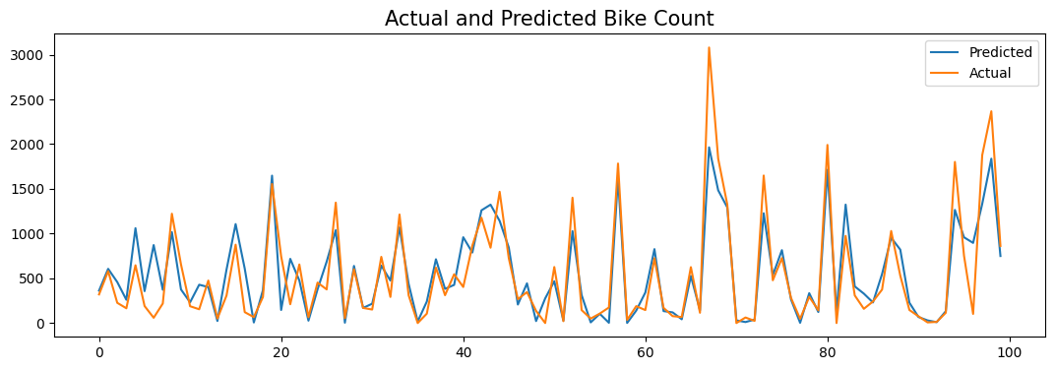
Modelling
Linear Regression
Performance (before tuning)
Performance (after tuning)

Slide 32
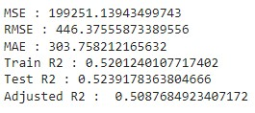
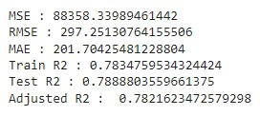
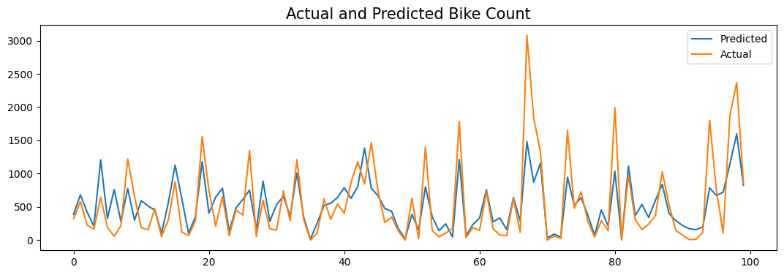
Modelling
Lasso Regression
Performance (before tuning)
Performance (after tuning)

Slide 33
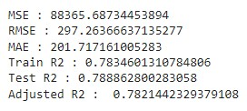
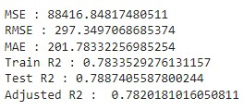
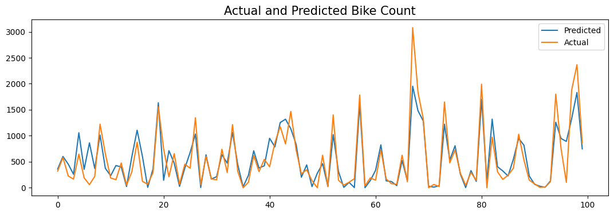
Modelling
Ridge Regression
Performance (before tuning)
Performance (after tuning)

Slide 34
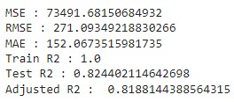
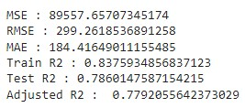
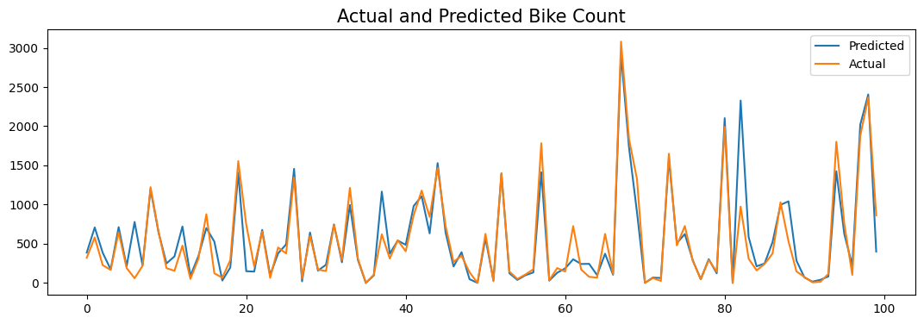
Modelling
Decision Tree
Performance (before tuning)
Performance (after tuning)

Slide 35
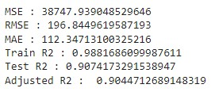
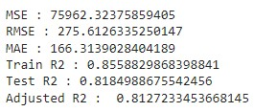
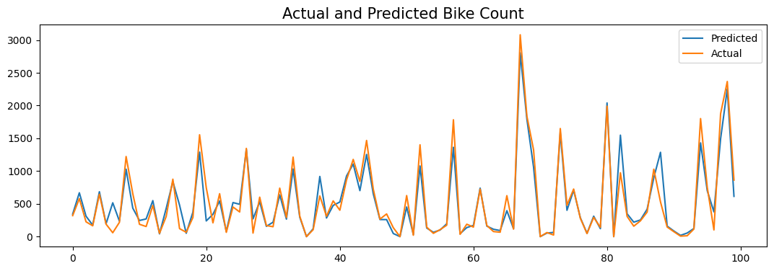
Modelling
Random Forest
Performance (before tuning)
Performance (after tuning)

Slide 36
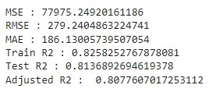
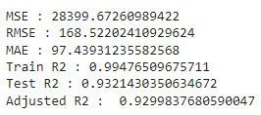
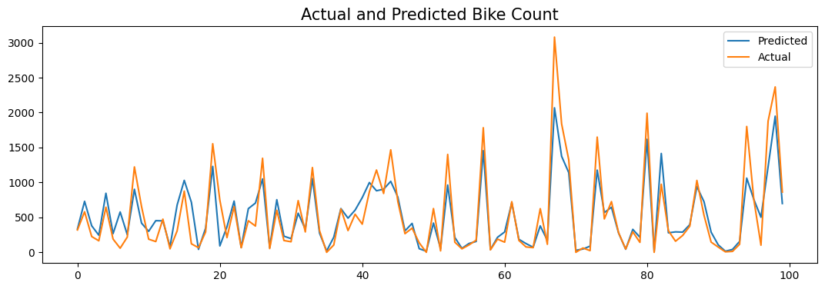
Modelling
Gradient Boosting
Performance (before tuning)
Performance (after tuning)

Slide 37
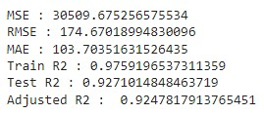
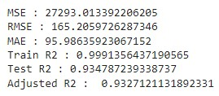
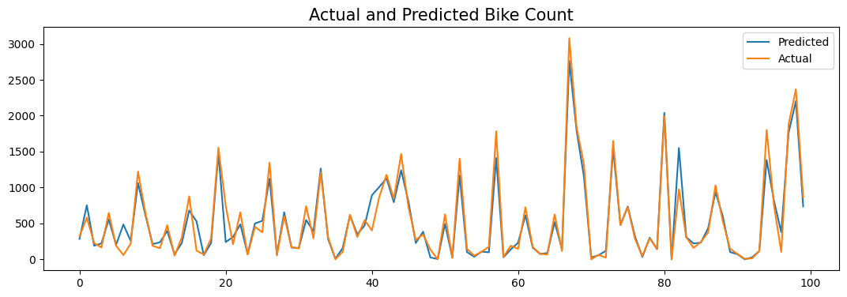
Modelling
Xtreme Gradient Boosting
Performance (before tuning)
Performance (after tuning)

Slide 38
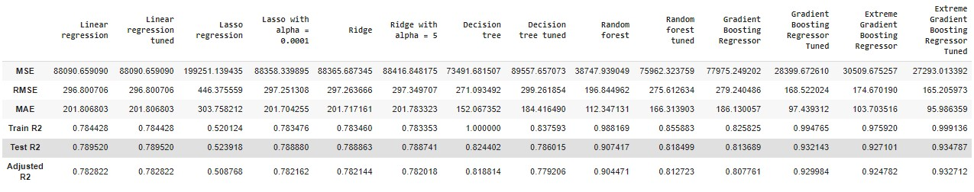
Modelling
Performance Comparison

Slide 39
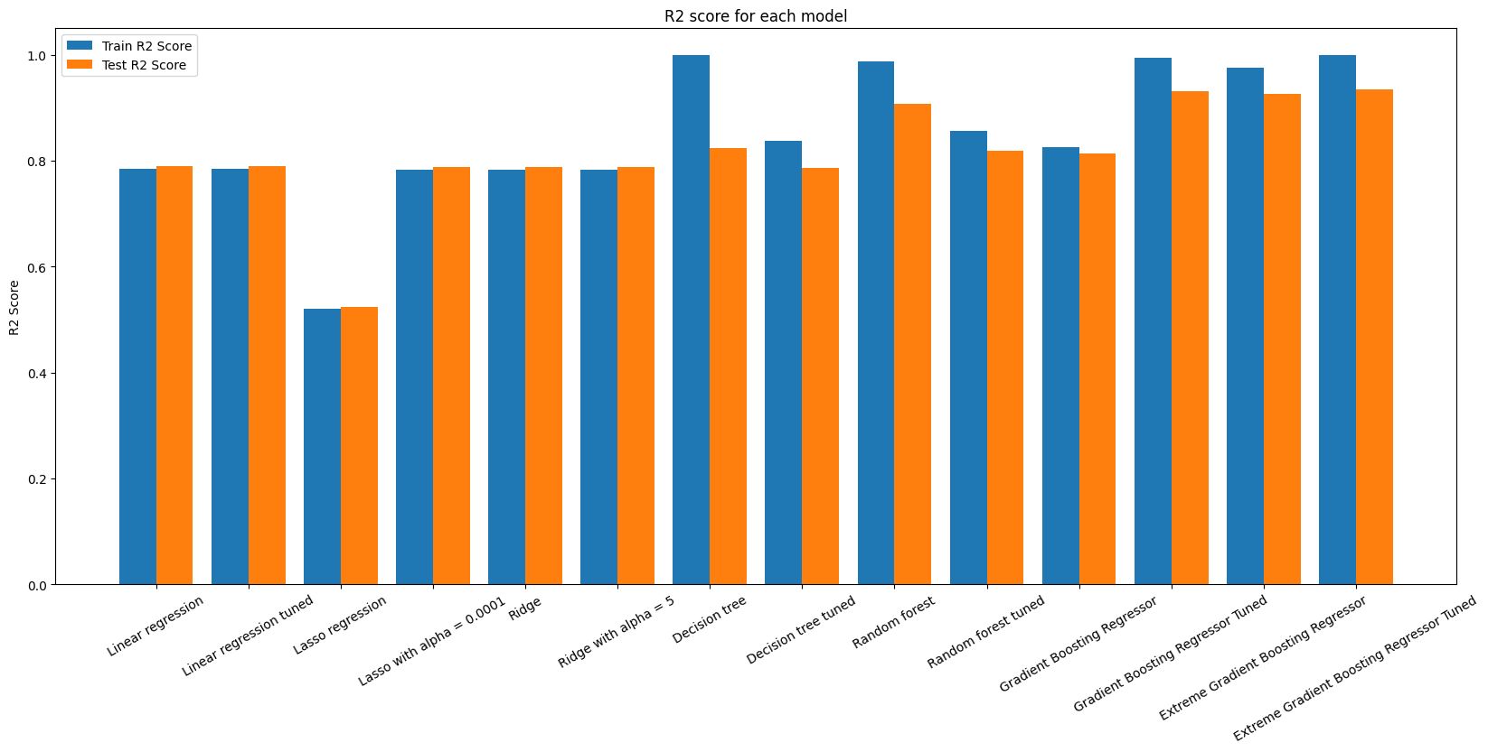
Modelling
Plot of R2 score for each model

Slide 40
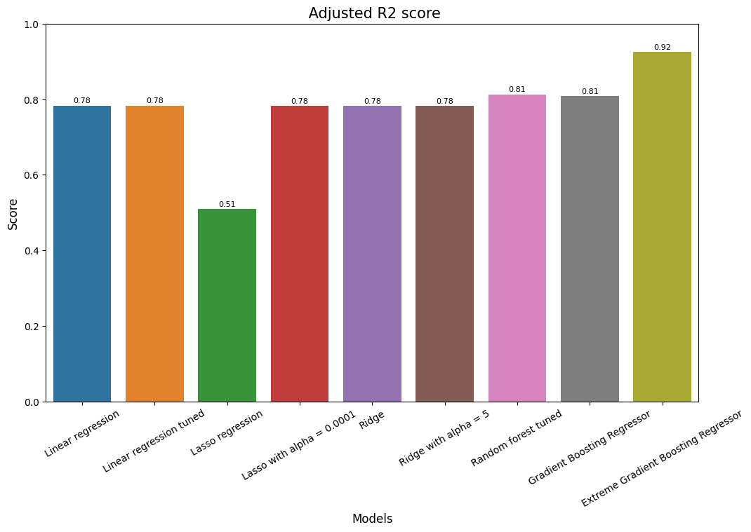
Modelling
Plot of adjusted R2 score

Slide 41
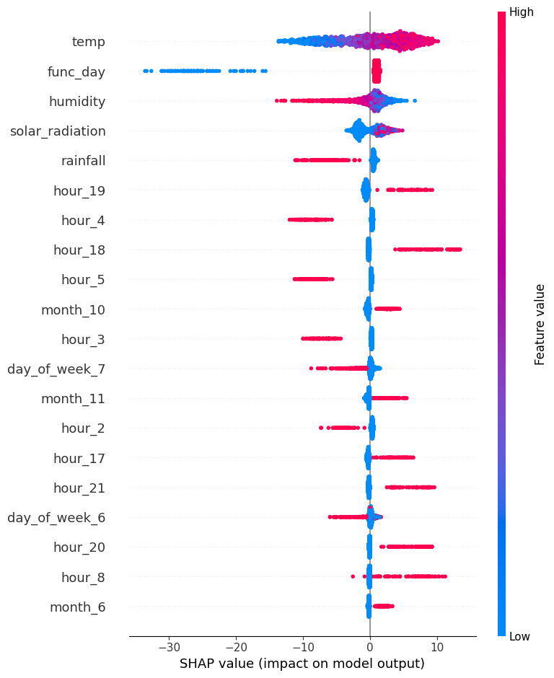
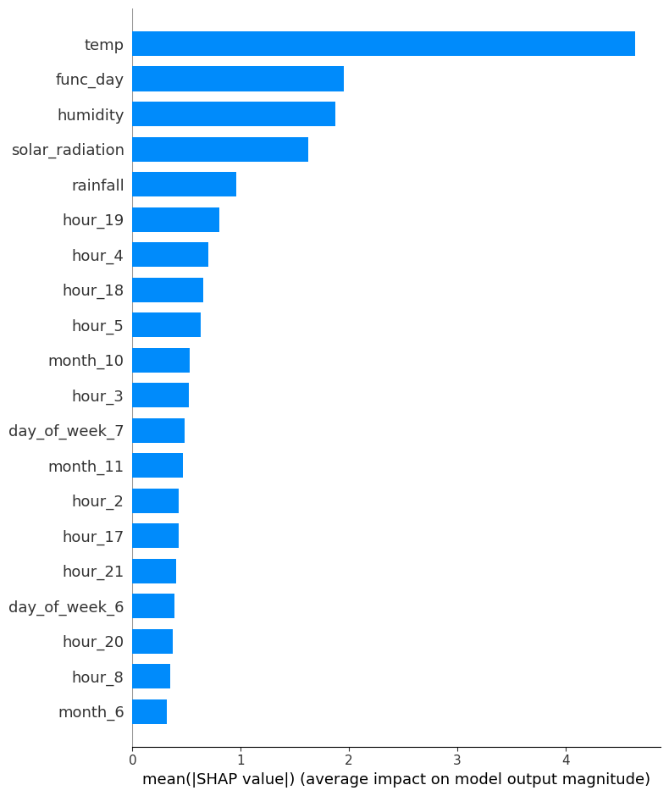
Model Interpretation

Slide 42
Conclusion
The XGBoost (Extreme Gradient Boosting) which gave the best result for predicting Rented Bike Count using several features on both train and test data with R2 score of 0.92.
There is no use of removing outliers, it affects negatively on model performance.

Slide 43
Thank You!

